Slide 1
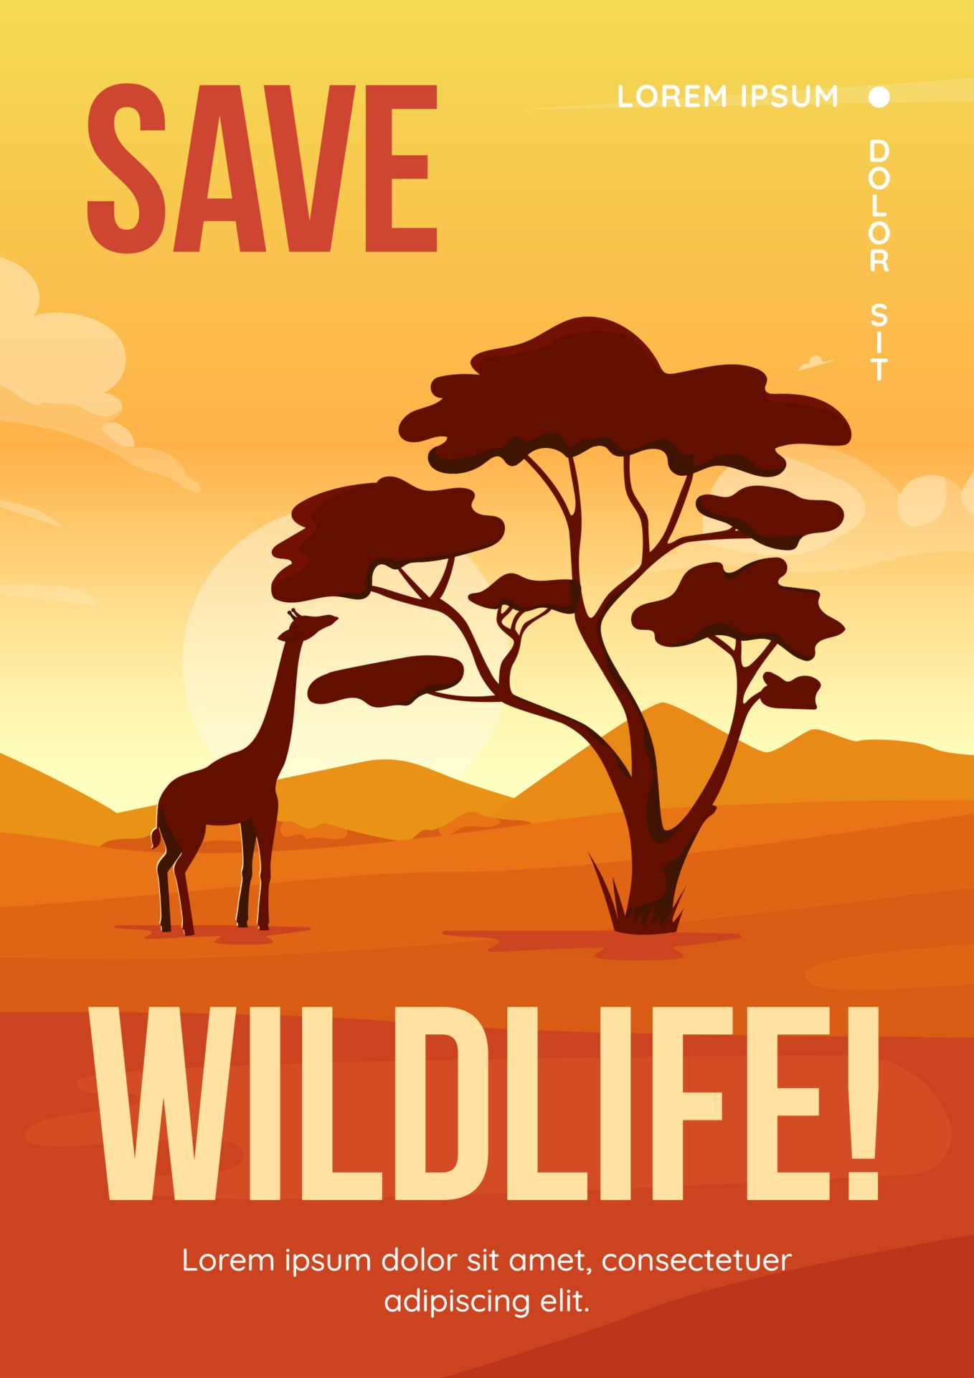

Slide 2
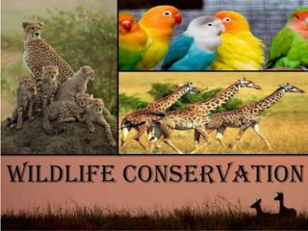
International Law
the Convention on International Trade in Endangered Species of Wild Flora and Fauna (CITES) 1973
Convention on the Conservation of Migratory Species of Wild Animals 1979
the Bio Diversity Convention 1992
the Ramsar Convention 1971
the World Heritage Convention 1972

Slide 3
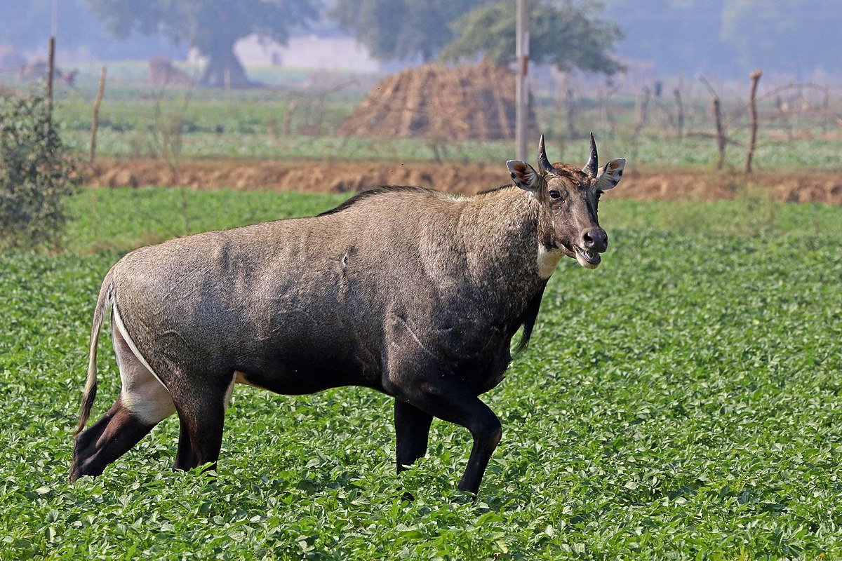
National Laws
Constitutional Provision: Article 18 A Article 18A of the Constitution of Bangladesh deals with the protection and improvement of environment and biodiversity and provides, “The State shall endeavor to protect and improve the environment and to preserve and safeguard the natural resources, bio-diversity, wetlands, forests and wild life for the present and future citizens”
the Wildlife (Preservation and Security) Act, 2012: this legislation is acting as the prime legal document for conservation of wildlife in Bangladesh.
The Forest Act 1927

Slide 4
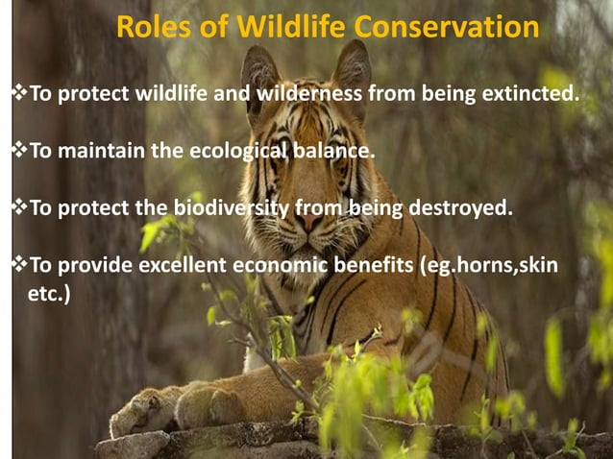

Slide 5
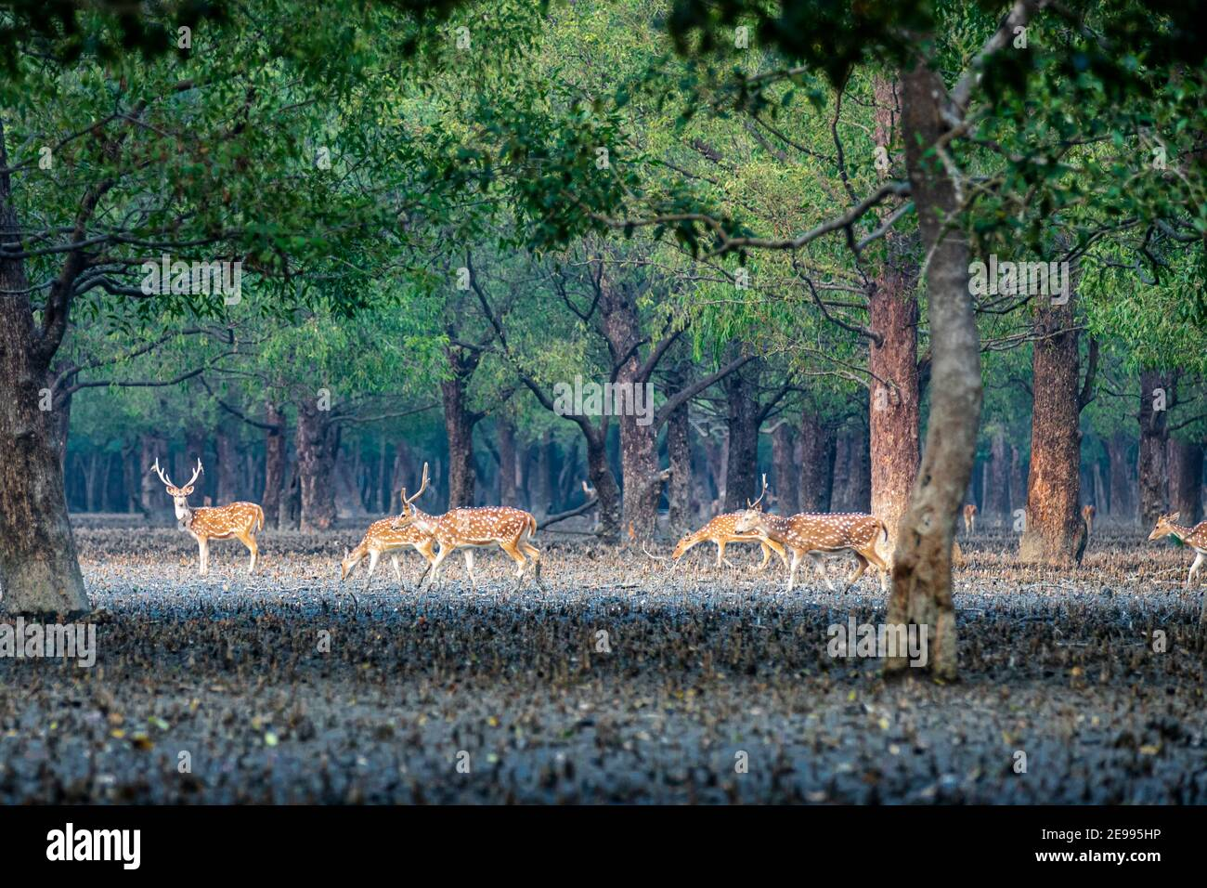
Sanctuaries
“sanctuary” means an area where capturing, killing, shooting or trapping of wildlife is prohibited and managed for the conservation of all natural resources such as vegetation, soil and water mainly for undisturbed breeding of wildlife and which is declared as such by notification in the official Gazette under section 13 of wildlife Conservation Act 2012.

Slide 6
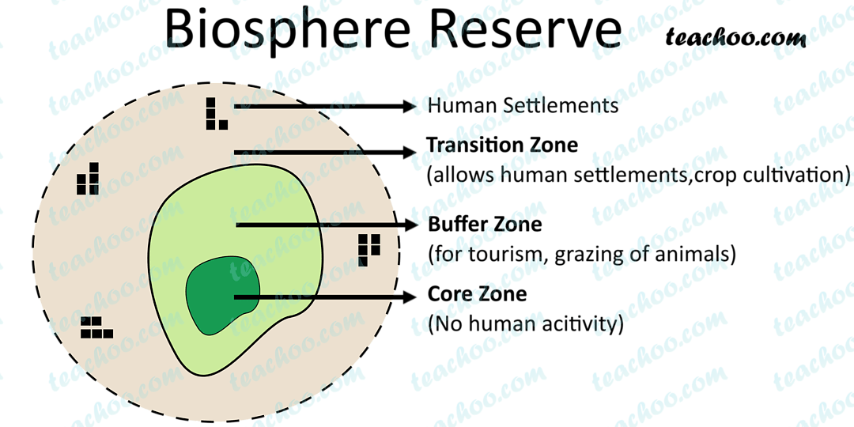
Buffer Zone
“buffer zone” means any forest lying in the margin of protected area or degraded forest area adjoining human habitation, except core zone, where local community people are inclined to harvest forest product and where there is scope for short rotation participatory forestry in harmony with plant species of the protected area and development of which ensures conservation of biodiversity and which is declared as such by notification in the official Gazette under section 20 of the Wildlife Conservation act

Slide 7
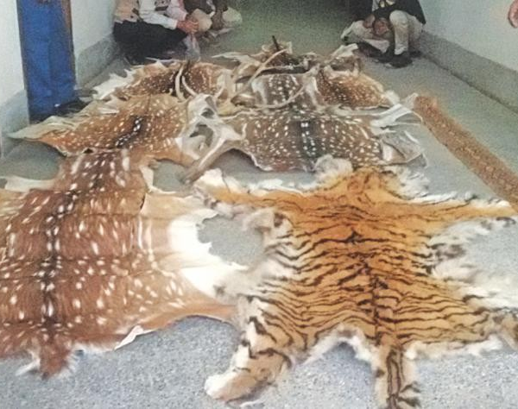
Wildlife Crime Control Unit (WCCU)
This was formed in 2012 by combining wildlife inspectors, forest guards, personnel of the Rapid Action Battalion, Coastguard, Customs, and Border Guard Bangladesh under the DoF to curb wildlife crime as defined by the Wildlife Conservation and Security Act, 2012, and in 2016, it established a forensic lab. It also maintains contact with local and international NGOs and organisations.

Slide 8
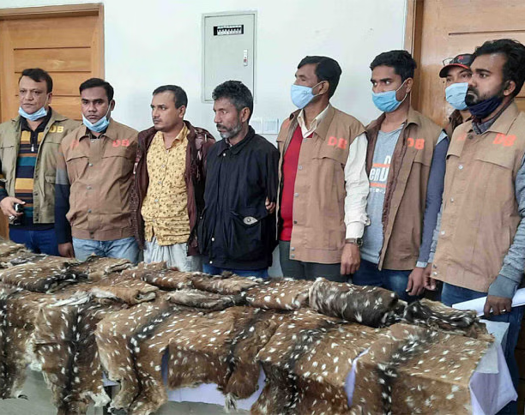
Police
To combat worldwide wildlife trafficking, the Bangladesh National Crime Bureau liaises with international agencies like INTERPOL and has achieved some successes with cases filed under the Wild Animal Preservation and Protection Act 2012, e.g. police of Bagerhat District in Sharankhola range arrested two alleged traffickers for trafficking 19 deer hides on 23 January 2021
Source: https://www.thedailystar.net/backpage/news/wildlife-trade-2-traffickers-arrested-deer-hides-2032737

Slide 9
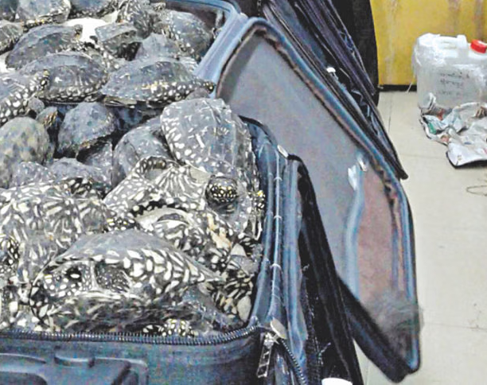
RAB
It is a paramilitary force founded in 2004. It functions as an anti-crime and anti-terrorism unit. Collaborating with other agencies, it conducts drives against the illicit traffickers: in September 2015, a joint drive led by the DoF recovered 4200 turtles and tortoises.
Source: https://www.thedailystar.net/frontpage/wildlife-trafficking-sees-sharp-rise-152602

Slide 10
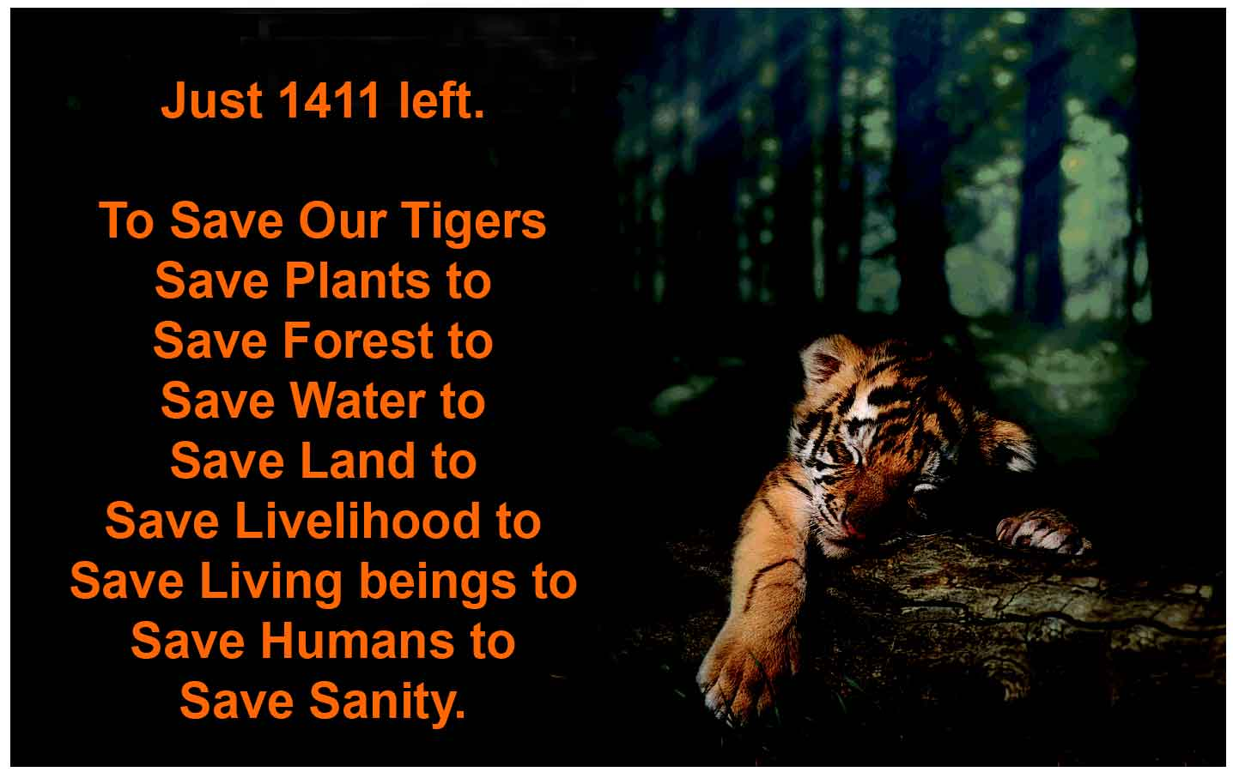

Steps are must be needed

